Slide 1
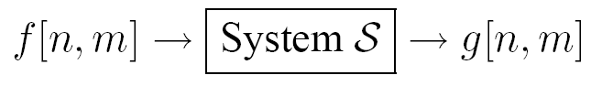
How do we characterize a linear shift invariant (LSI) system?
Mathematically, how do you calculate g[n,m] from f[n,m]

Slide 2
Linear Systems (filters)
Is the moving average a linear system?
Is thresholding a linear system?
f1[n,m] + f2[n,m] > T
f1[n,m] < T
f2[n,m]<T
No!
Notes:
Show on the board equations for moving average.

Slide 3
2D impulse function
1 at [0,0].
0 everywhere else

Slide 4
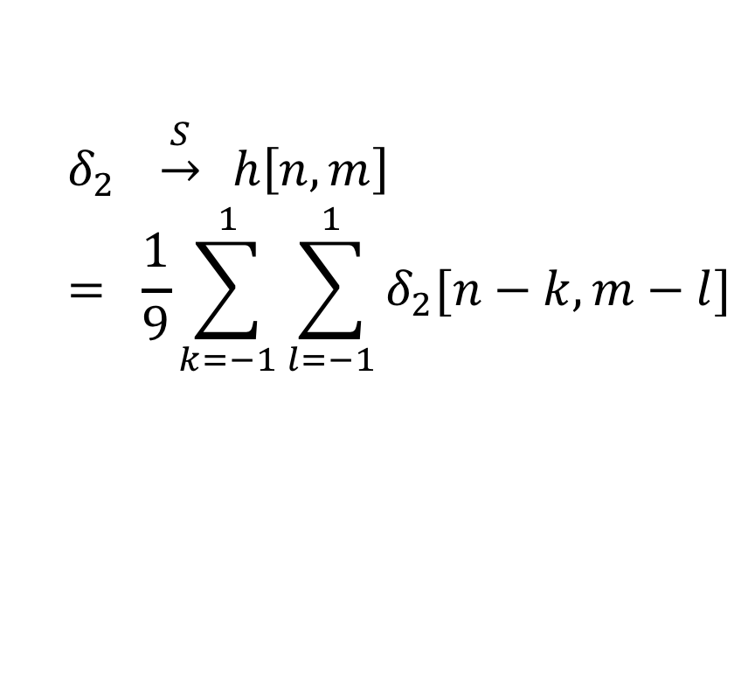
Impulse response to the moving filter
$$δ_{2} \underset{→}{S} h\left[n,m\right]$$
$$= \frac{1}{9}\sum_{k=−1}^{1}{\sum_{l=−1}^{1}{δ_{2}[n−k,m−l]}}$$
Notes:
LSI systems can be characterized by the impulse response.
\delta_2 is the impulse (an image with 1 pixel =1, all the rest =0)
h is the response

Slide 5
Impulse response to the moving filter
$$δ_{2} \underset{→}{S} h\left[n,m\right]$$
$$= \frac{1}{9}\sum_{k=−1}^{1}{\sum_{l=−1}^{1}{δ_{2}[n−k,m−l]}}$$
?
h[0,0]
g[0,0]
Notes:
LSI systems can be characterized by the impulse response.
\delta_2 is the impulse (an image with 1 pixel =1, all the rest =0)
h is the response

Slide 6
Impulse response to the moving filter
$$δ_{2} \underset{→}{S} h\left[n,m\right]$$
$$= \frac{1}{9}\sum_{k=−1}^{1}{\sum_{l=−1}^{1}{δ_{2}[n−k,m−l]}}$$
1/9
?
h[0,0]
h[0,1]
g[0,0]
Notes:
LSI systems can be characterized by the impulse response.
\delta_2 is the impulse (an image with 1 pixel =1, all the rest =0)
h is the response

Slide 7
Impulse response to the moving filter
$$δ_{2} \underset{→}{S} h\left[n,m\right]$$
$$= \frac{1}{9}\sum_{k=−1}^{1}{\sum_{l=−1}^{1}{δ_{2}[n−k,m−l]}}$$
1/9
1/9
h[0,0]
h[0,1]
?
g[0,0]
h[1,1]
Notes:
LSI systems can be characterized by the impulse response.
\delta_2 is the impulse (an image with 1 pixel =1, all the rest =0)
h is the response

Slide 8
Impulse response to the moving filter
$$δ_{2} \underset{→}{S} h\left[n,m\right]$$
$$= \frac{1}{9}\sum_{k=−1}^{1}{\sum_{l=−1}^{1}{δ_{2}[n−k,m−l]}}$$
1/9
1/9
h[0,0]
h[0,1]
1/9
g[0,0]
h[1,1]
Notes:
LSI systems can be characterized by the impulse response.
\delta_2 is the impulse (an image with 1 pixel =1, all the rest =0)
h is the response

Slide 9
Impulse response to the moving filter
$$δ_{2} \underset{→}{S} h\left[n,m\right]$$
$$= \frac{1}{9}\sum_{k=−1}^{1}{\sum_{l=−1}^{1}{δ_{2}[n−k,m−l]}}$$
1/9
1/9
?
h[0,0]
h[0,1]
h[0,2]
1/9
g[0,0]
h[1,1]
Notes:
LSI systems can be characterized by the impulse response.
\delta_2 is the impulse (an image with 1 pixel =1, all the rest =0)
h is the response

Slide 10
Impulse response to the moving filter
$$δ_{2} \underset{→}{S} h\left[n,m\right]$$
$$= \frac{1}{9}\sum_{k=−1}^{1}{\sum_{l=−1}^{1}{δ_{2}[n−k,m−l]}}$$
1/9
1/9
0
h[0,0]
h[0,1]
h[0,2]
1/9
g[0,0]
h[1,1]
Notes:
LSI systems can be characterized by the impulse response.
\delta_2 is the impulse (an image with 1 pixel =1, all the rest =0)
h is the response

Slide 11
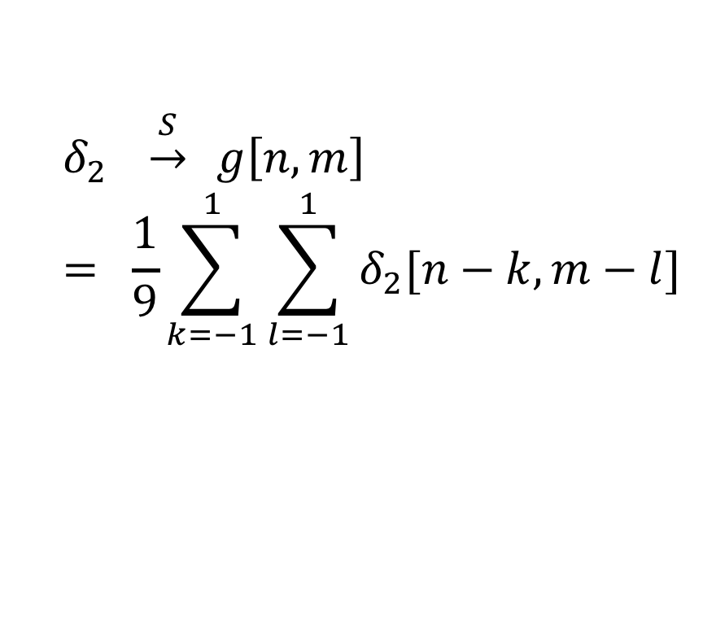
Impulse response to the moving filter
0
0
0
0
0
0
1/9
1/9
1/9
0
h[-1,-1]
$$δ_{2} \underset{→}{S} g\left[n,m\right]$$
$$= \frac{1}{9}\sum_{k=−1}^{1}{\sum_{l=−1}^{1}{δ_{2}[n−k,m−l]}}$$
0
1/9
1/9
1/9
0
h[0,0]
h[0,1]
h[0,2]
0
1/9
1/9
1/9
0
g[0,0]
h[1,1]
0
0
0
0
0
Notes:
LSI systems can be characterized by the impulse response.
\delta_2 is the impulse (an image with 1 pixel =1, all the rest =0)
h is the response

Slide 12
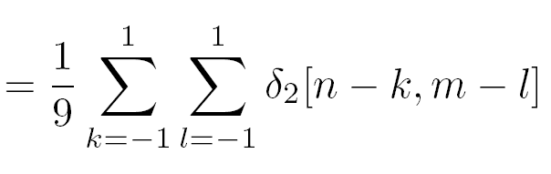
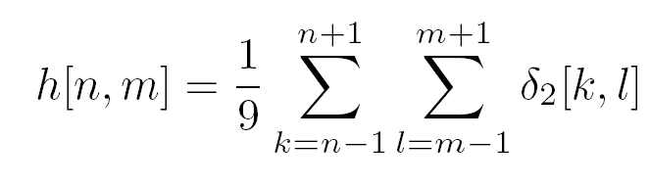

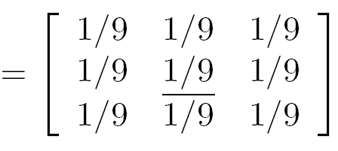
Impulse response of the 3 by 3 moving average filter
h
1
1
1
1
1
1
1
1
1

Slide 13
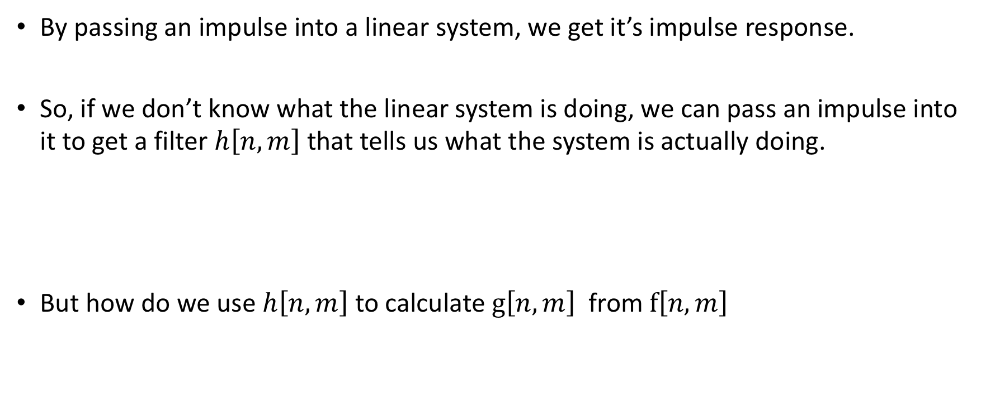
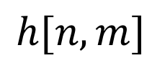
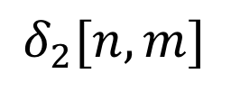
Any linear shift invariant system
By passing an impulse into a linear system, we get it’s impulse response.
So, if we don’t know what the linear system is doing, we can pass an impulse into it to get a filter $h\left[n,m\right]$ that tells us what the system is actually doing.
But how do we use $h\left[n,m\right]$ to calculate $g\left[n,m\right]$ from $f\left[n,m\right]$
$$δ_{2}[n,m]$$
$$h[n,m]$$

Slide 14
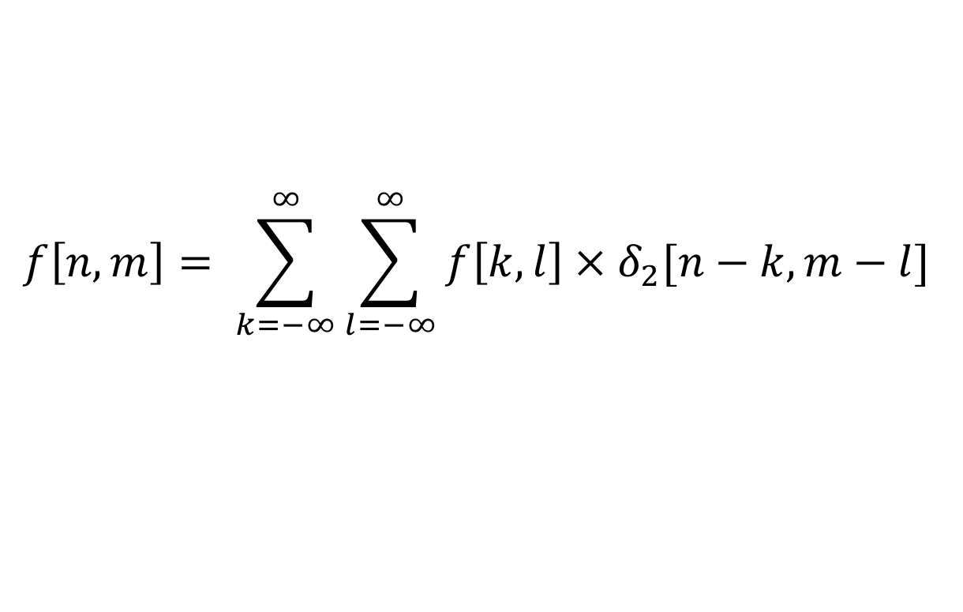

General linear shift invariant system
Let’s say our input f is a 3x3 image:
We can rewrite $f\left[n,m\right]$ as a sum of delta functions:
$f\left[n,m\right]=f\left[0,0\right] × δ_{2}$[$n−0,m−0$]
$+ f\left[0,1\right]$ ${× δ}_{2}[n−0,m−1]$
$+ f\left[0,2\right]{ × δ}_{2}[n−0,m−2]$
$+ …$
f[0,0]
f[0,1]
f[1,1]
f[1,0]
f[1,1]
f[1,2]
f[2,0]
f[2,1]
f[2,2]
$$f\left[n,m\right]= \sum_{k=−∞}^{∞}{\sum_{l=−∞}^{∞}{f\left[k,l\right]{ × δ}_{2}[n−k,m−l] }}$$
Or you can write it as:

Slide 15
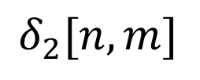

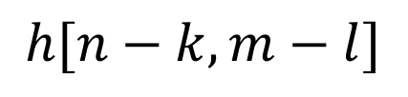
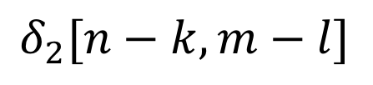
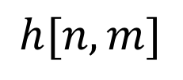
3 properties we need:
Now, we know what happens when we send a delta function through a LSI system:
$$δ_{2}[n,m]$$
$$h[n,m]$$
We also know that LSI systems shift the output if the input is shifted:
$$δ_{2}[n−k,m−l]$$
$$h[n−k,m−l]$$
Finally, the superposition principle:
$${S[ αf}_{i}\left[n,m\right]+ βf_{j}\left[k,l\right] ] = {α S[ f}_{i}\left[n,m\right]] + β S[ f_{j}\left[k,l\right] ]$$

Slide 16
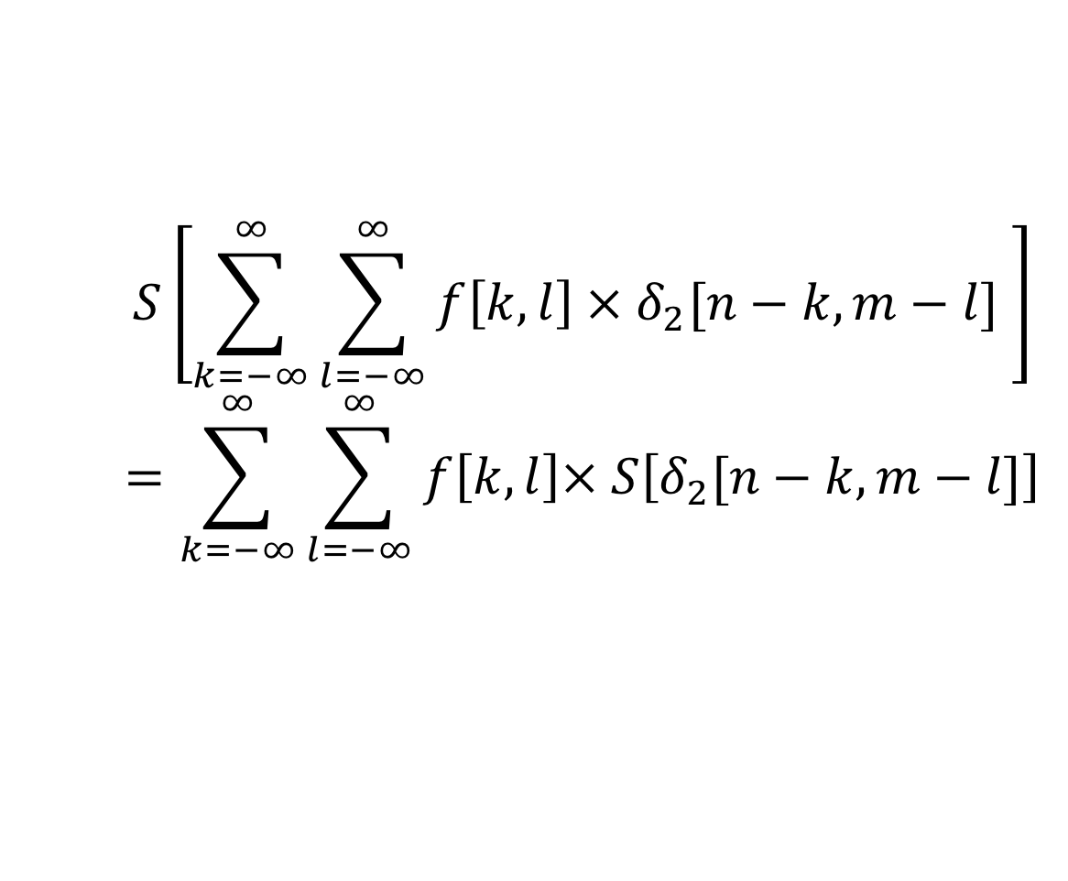

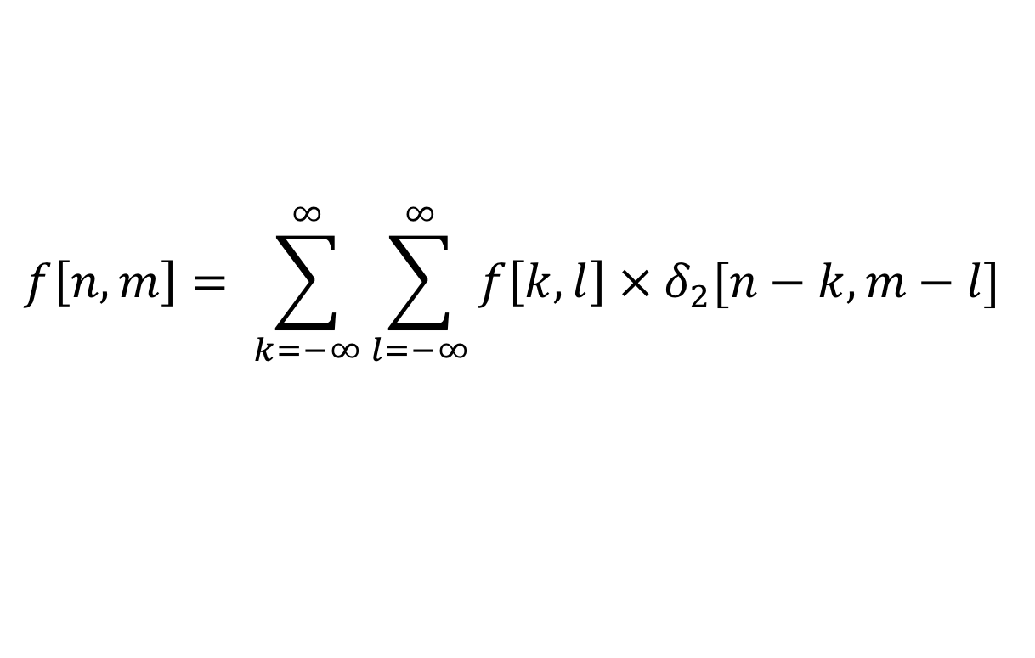
We can generalize this superposition principle…
$${S[ αf}_{i}\left[n,m\right]+ βf_{j}\left[k,l\right] ] = {α S[ f}_{i}\left[n,m\right]] + β S[ f_{j}\left[k,l\right] ]$$
… with our summation of deltas…
$$f\left[n,m\right]= \sum_{k=−∞}^{∞}{\sum_{l=−∞}^{∞}{f\left[k,l\right]{ × δ}_{2}[n−k,m−l] }}$$
… as follows:
$$S\left[\sum_{k=−∞}^{∞}{\sum_{l=−∞}^{∞}{f\left[k,l\right]{ × δ}_{2}[n−k,m−l] }}\right]$$
$$=\sum_{k=−∞}^{∞}{\sum_{l=−∞}^{∞}{f\left[k,l\right]× S\left[δ_{2}[n−k,m−l]\right]}}$$

Slide 17
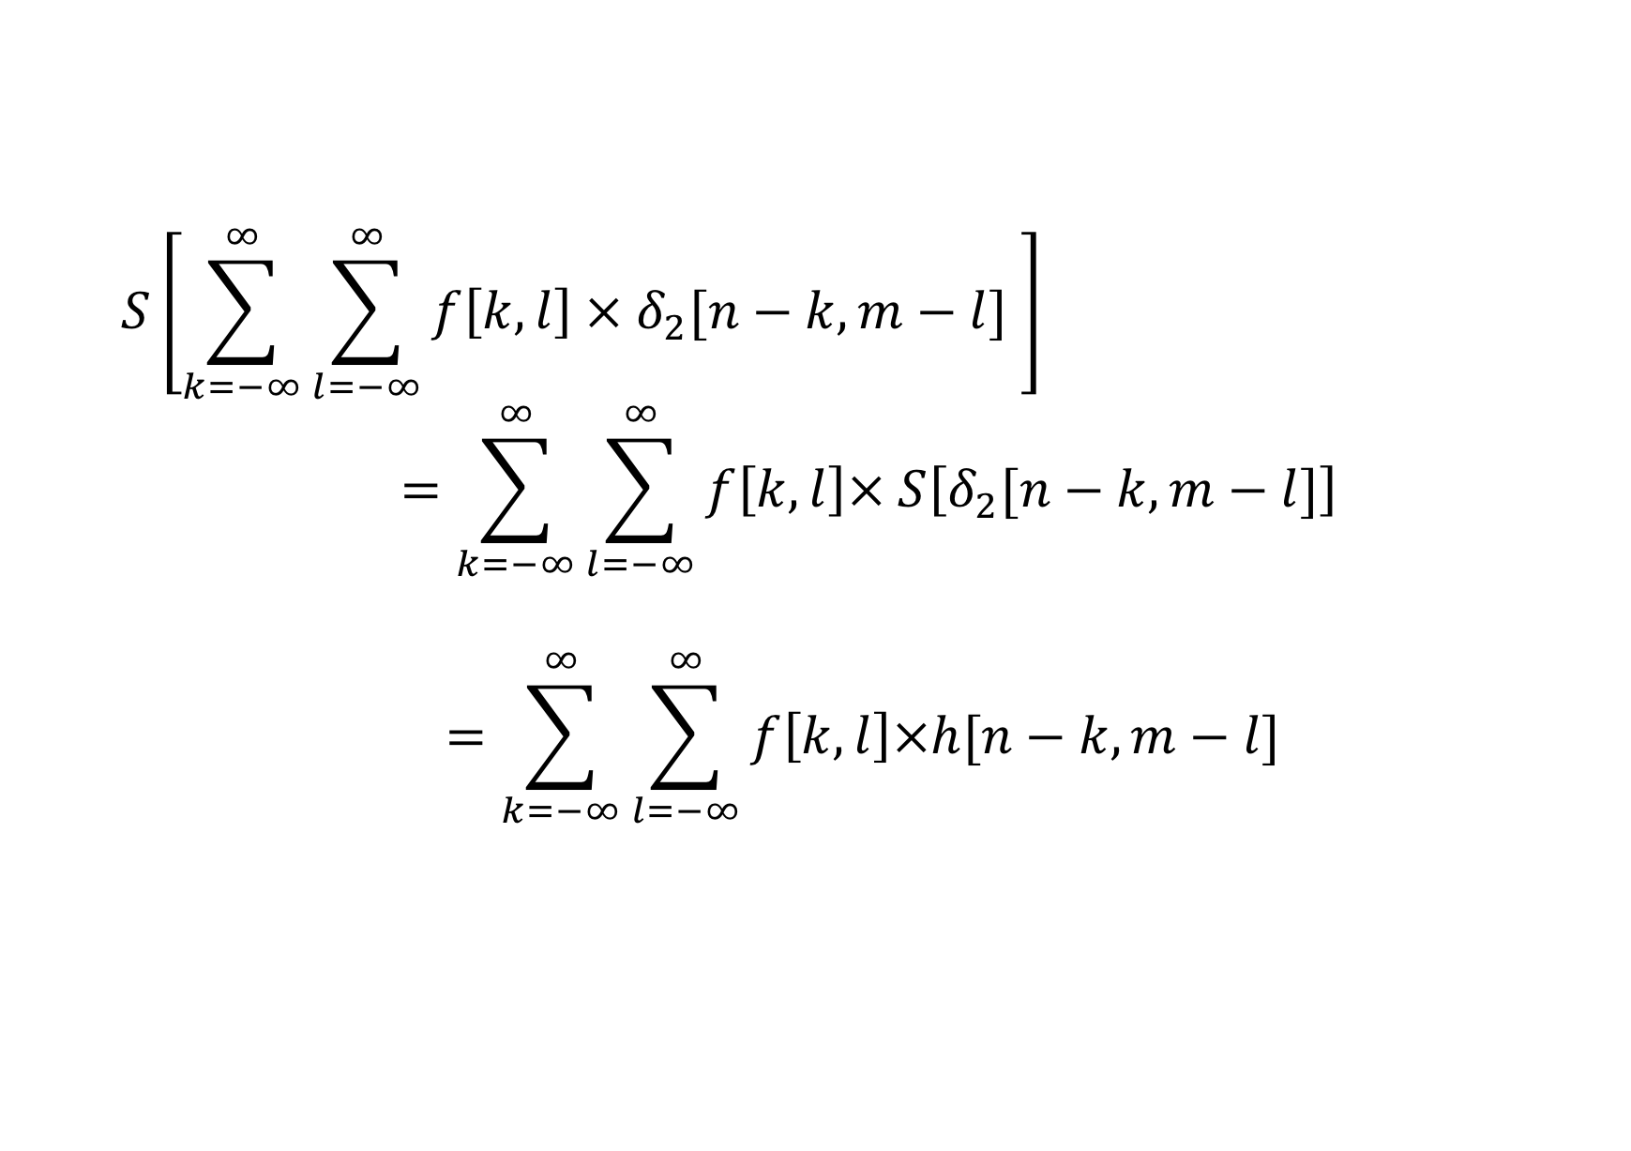
Linear shift invariant system
$$S\left[\sum_{k=−∞}^{∞}{\sum_{l=−∞}^{∞}{f\left[k,l\right]{ × δ}_{2}[n−k,m−l] }}\right]$$
$$=\sum_{k=−∞}^{∞}{\sum_{l=−∞}^{∞}{f\left[k,l\right]× S\left[δ_{2}[n−k,m−l]\right]}}$$
$$=\sum_{k=−∞}^{∞}{\sum_{l=−∞}^{∞}{f\left[k,l\right]×h[n−k,m−l] }}$$

Slide 18
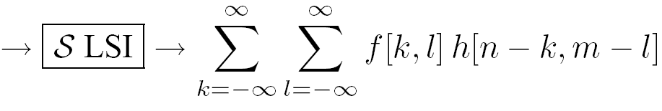
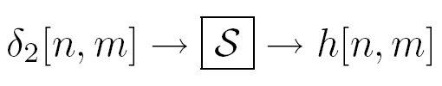
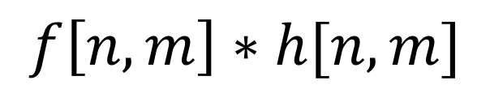
Linear Shift Invariant systems
An LSI system is completely specified by its impulse response.
Discrete convolution
$$f\left[n,m\right]∗h[n,m]$$
Notes:
We can write any function as a sum of impulses…
Let’s pass this function over our system..
Using superposition, we get a sum over the impulse responses…
Final equation: we call this a convolution. Applying the impulse response h to f at all locations.

Slide 19
Convolution

Slide 20

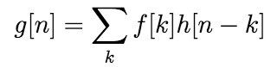
1D Discrete convolution (symbol: )
We are going to convolve a function f with a filter h.
h[k,l]
f[k,l]

Slide 21
1D Discrete convolution (symbol: )
We are going to convolve a function f with a filter h.
We first need to calculate h[n-k]
h[-k]
h[k]
h[n-k]

Slide 22
Discrete convolution (symbol: )
We are going to convolve a function f with a filter h.
h[-2-k]
g[-2]
f[k]

Slide 23
Discrete convolution (symbol: )
We are going to convolve a function f with a filter h.
h[-1-k]
g[-1]
f[k]

Slide 24
Discrete convolution (symbol: )
We are going to convolve a function f with a filter h.
h[-k]
g[0]
f[k]

Slide 25
Discrete convolution (symbol: )
We are going to convolve a function f with a filter h.
h[1-k]
g[1]
f[k]

Slide 26
Discrete convolution (symbol: )
We are going to convolve a function f with a filter h.
h[2-k]
g[2]
f[k]

Slide 27
Discrete convolution (symbol: )
We are going to convolve a function f with a filter h.
h[n-k]
g[n]
f[k]

Slide 28
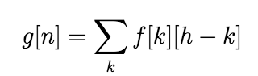
Discrete convolution (symbol: )
In summary, the steps for discrete convolution are:
Fold h[k,l] about origin to form h[−k]
Shift the folded results by n to form h[n − k]
Multiply h[n − k] by f[k]
Sum over all k
Repeat for every n

Slide 29
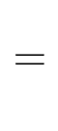
2D convolution
2D convolution is very similar to 1D.
The main difference is that we now have to iterate over 2 axis instead of 1.
Assume we have a filter(h[,]) that is 3x3. and an image (f[,]) that is 7x7.

Slide 30
2D convolution
2D convolution is very similar to 1D.
The main difference is that we now have to iterate over 2 axis instead of 1.
Assume we have a filter(h[,]) that is 3x3. and an image (f[,]) that is 7x7.

Slide 31
2D convolution
2D convolution is very similar to 1D.
The main difference is that we now have to iterate over 2 axis instead of 1.
Assume we have a filter(h[,]) that is 3x3. and an image (f[,]) that is 7x7.

Slide 32
2D convolution
2D convolution is very similar to 1D.
The main difference is that we now have to iterate over 2 axis instead of 1.
Assume we have a filter(h[,]) that is 3x3. and an image (f[,]) that is 7x7.

Slide 33
2D convolution
2D convolution is very similar to 1D.
The main difference is that we now have to iterate over 2 axis instead of 1.
Assume we have a filter(h[,]) that is 3x3. and an image (f[,]) that is 7x7.

Slide 34
2D convolution
2D convolution is very similar to 1D.
The main difference is that we now have to iterate over 2 axis instead of 1.
Assume we have a filter(h[,]) that is 3x3. and an image (f[,]) that is 7x7.

Slide 35
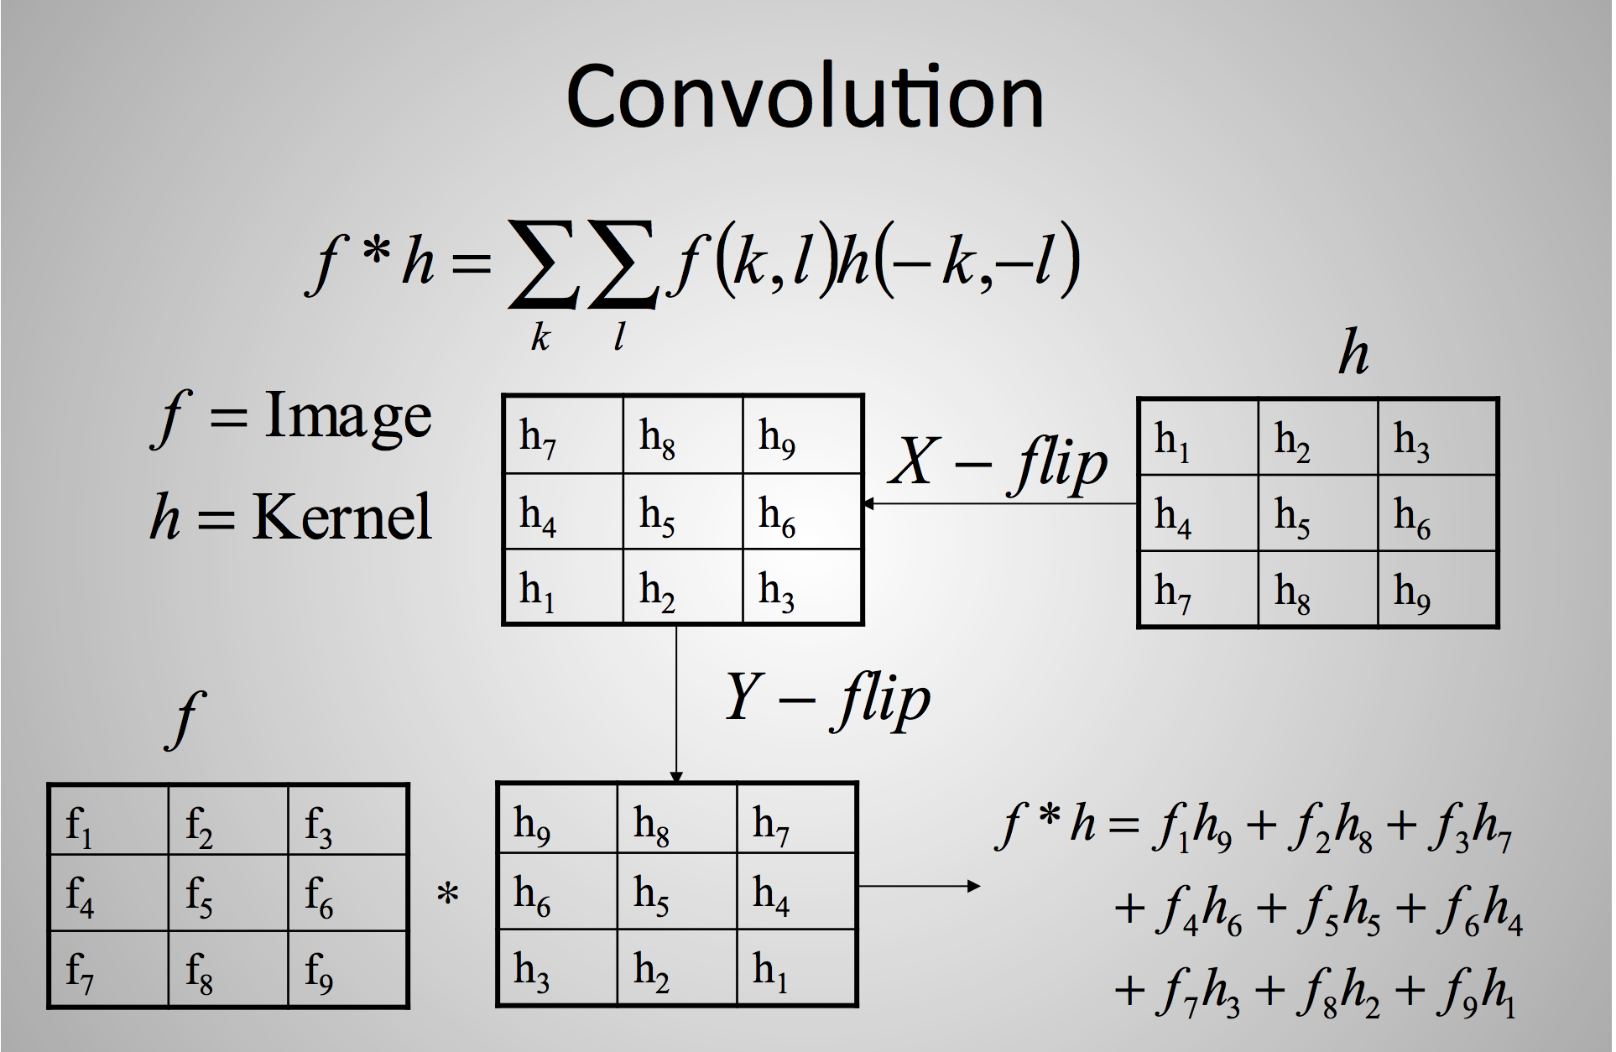
Slide credit: Ulas Bagci

Slide 36
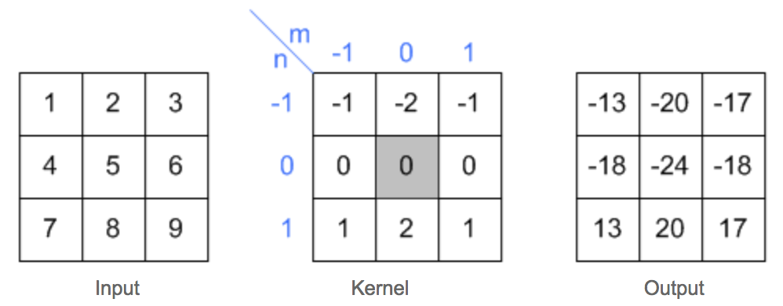
2D convolution example
Slide credit: Song Ho Ahn

Slide 37
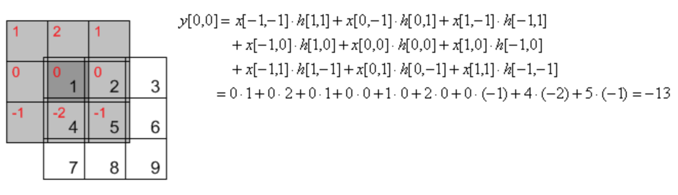
2D convolution example
Slide credit: Song Ho Ahn

Slide 38
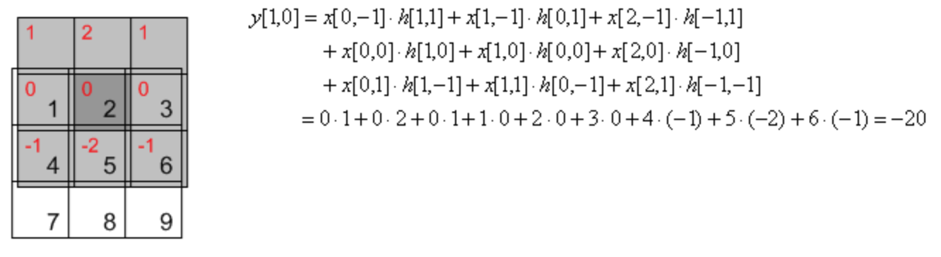
2D convolution example
Slide credit: Song Ho Ahn

Slide 39
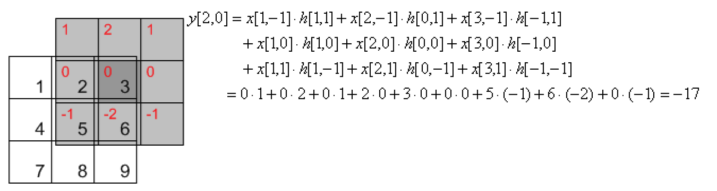
2D convolution example
Slide credit: Song Ho Ahn

Slide 40
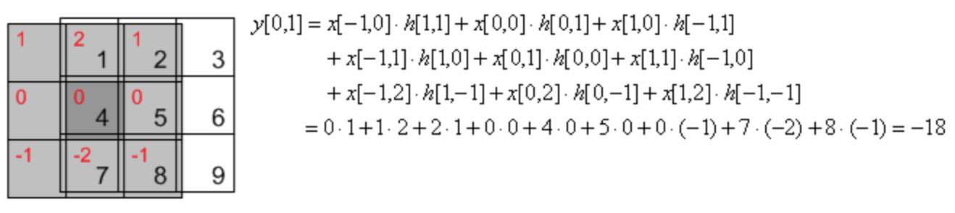
2D convolution example
Slide credit: Song Ho Ahn

Slide 41
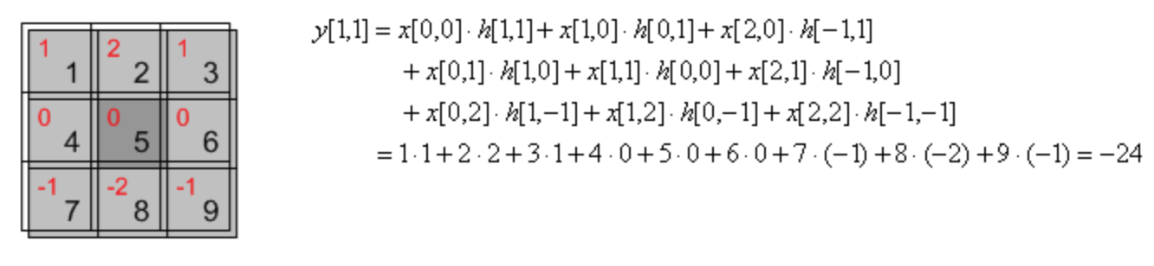
2D convolution example
Slide credit: Song Ho Ahn

Slide 42
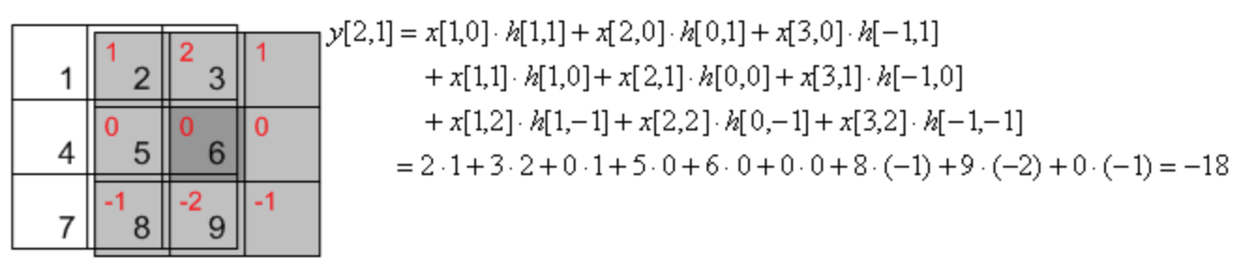
2D convolution example
Slide credit: Song Ho Ahn

Slide 43
Convolution in 2D - examples
0
0
0
?
*
=
0
1
0
0
0
0
Original

Slide 44
Convolution in 2D - examples
0
0
0
*
=
0
1
0
0
0
0
Original
Filtered
(no change)

Slide 45
Convolution in 2D - examples
0
0
0
?
*
=
0
0
1
0
0
0
Original

Slide 46
Convolution in 2D - examples
0
0
0
*
=
0
0
1
0
0
0
Original
Shifted right
By 1 pixel

Slide 47
Convolution in 2D - examples
1
1
1
?
*
=
1
1
1
1
1
1
Original

Slide 48
Convolution in 2D - examples
*
1
1
1
=
1
1
1
1
1
1
Original
Blur (with a
box filter)

Slide 49

Convolution in 2D - examples
0
0
0
-
1
1
1
= ?
0
2
0
1
1
1
0
0
0
1
1
1
Original
(Note that filter sums to 1)
“details of the image”
0
0
0
0
0
0
-
1
1
1
0
1
0
+
0
1
0
1
1
1
0
0
0
0
0
0
1
1
1
Notes:
Original image – blur = details!

Slide 50
What does blurring take away?
–
=
original
smoothed (5x5)
Detailed
Let’s add it back:
+
=
original
Detailed
Sharpened

Slide 51
Convolution in 2D – Sharpening filter
0
0
0
-
1
1
1
=
0
2
0
1
1
1
0
0
0
1
1
1
Original
Sharpening filter: Accentuates differences with local average

